Slide 1


Drops of LTSpice
How to do AC Analysis?

Slide 2
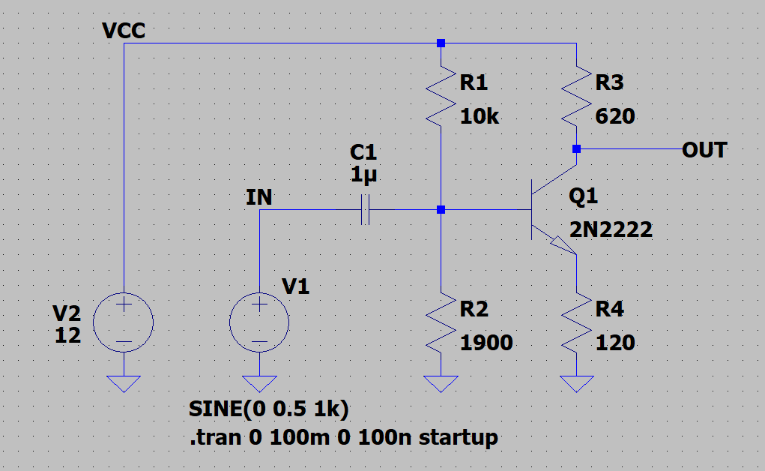
Let's imagine you've made a transistor amplifier.

Slide 3
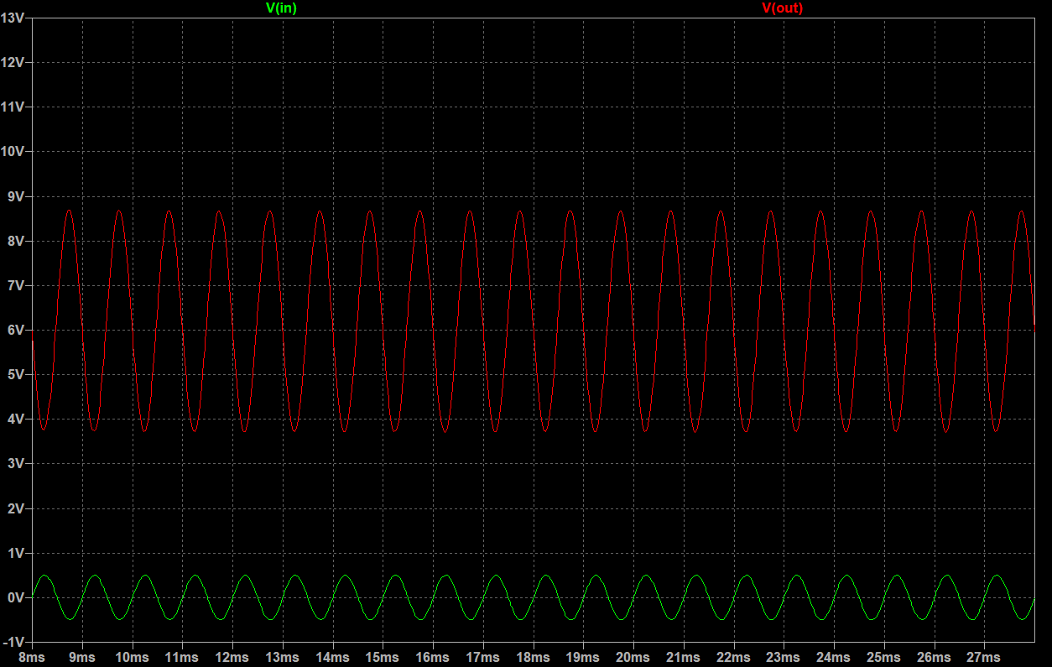
Of course it works great!

Slide 4
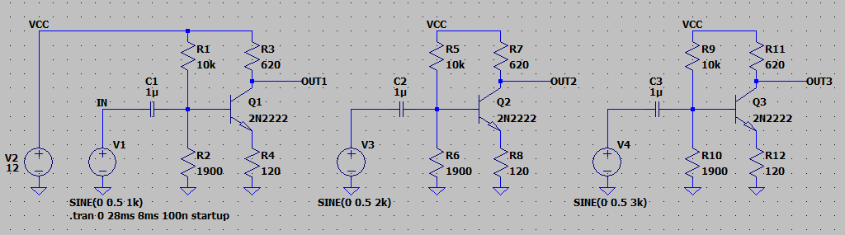
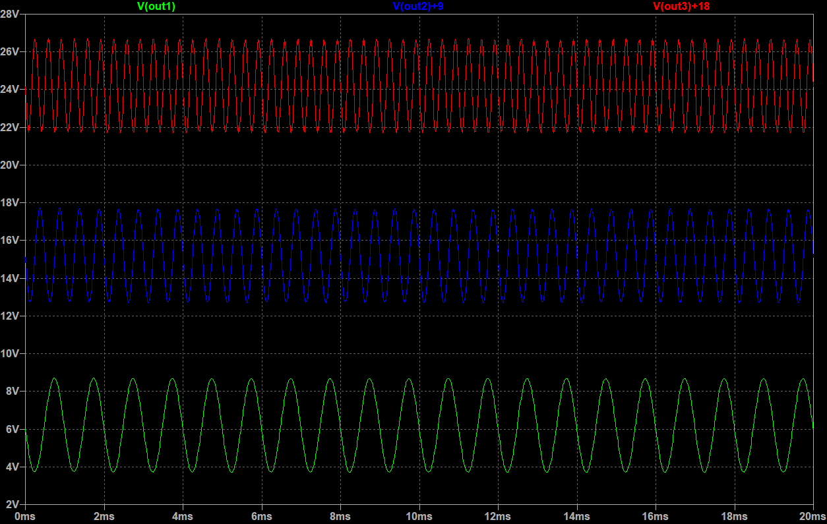
But how does it behave at different frequencies?
It's hard to test all the possibilities.

Slide 5
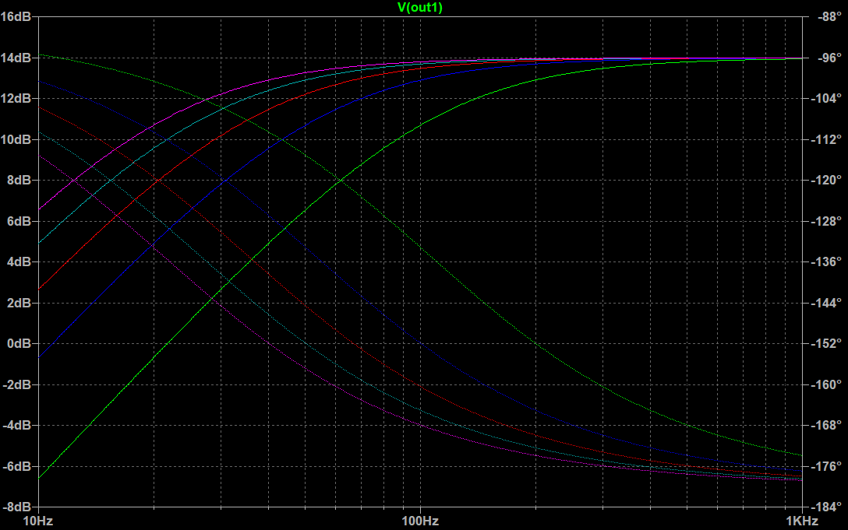
But there is a simpler way!
LTSpice analyzes the frequency response for you.

Slide 6
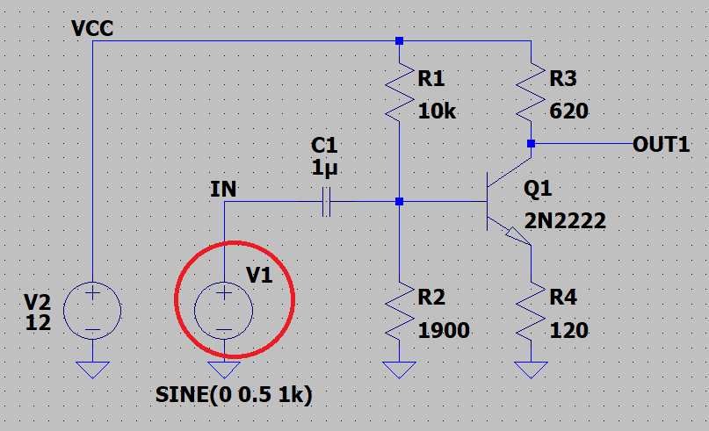
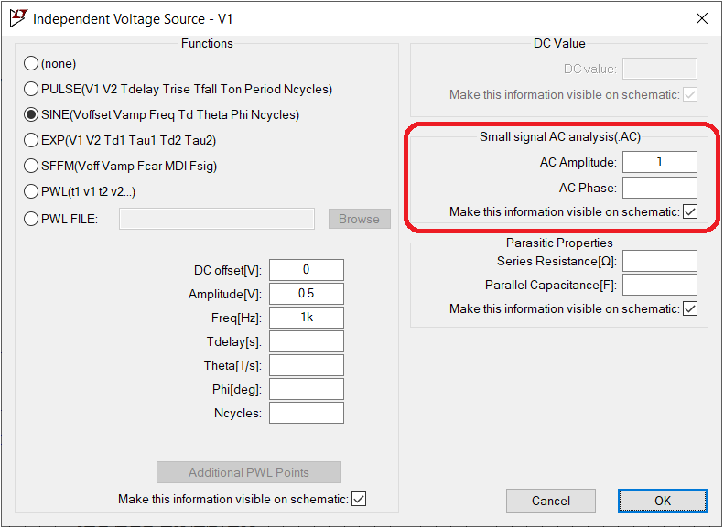
First, let's open the advanced properties of your signal source.
Write 1 in the AC Amplitude. This value means 0dB, which will make our analysis simpler.

Slide 7
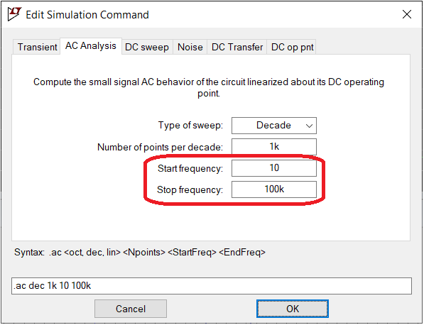
Change the simulation command to AC Analysis. For this circuit, the 10Hz to 100KHz range looks good.

Slide 8
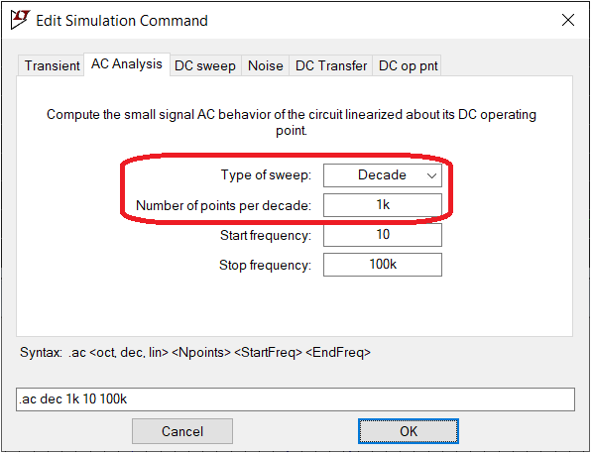
The X-axis is typically logarithmic, and 1K per decade is fine.

Slide 9
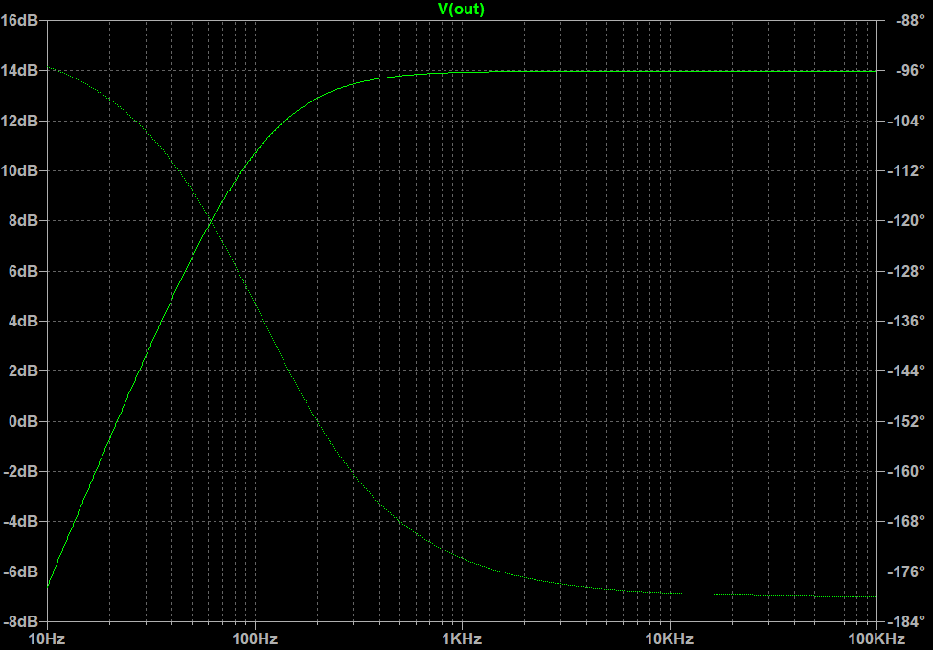
And that's it. Your circuit now displays the frequency response!

Slide 10
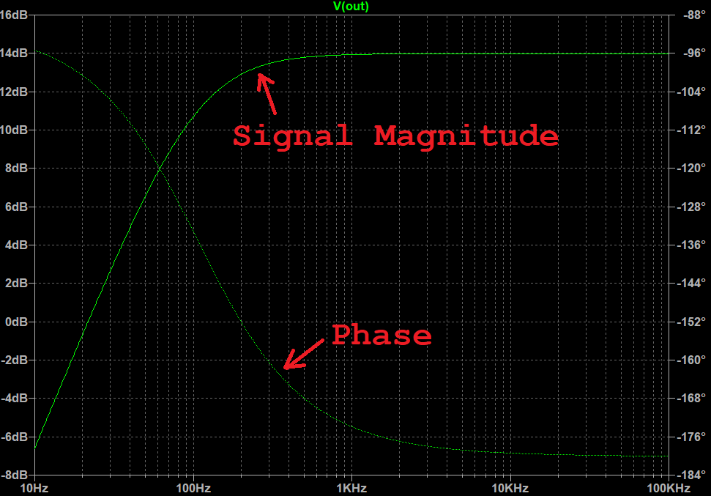
The solid line is the frequency response. The dotted line is the phase of the signal.

Slide 11
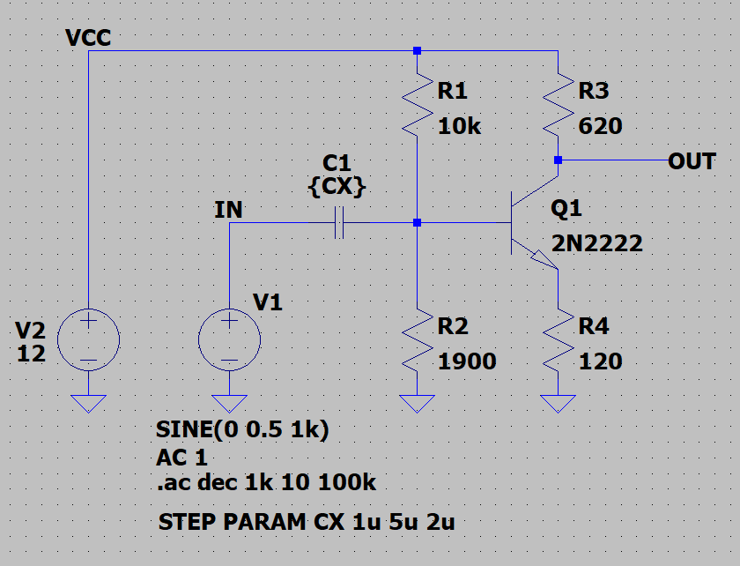
Using the STEP directive, you can parse multiple component values.
Here I tested the capacitor between 1uF, 3uF and 5uF.

Slide 12
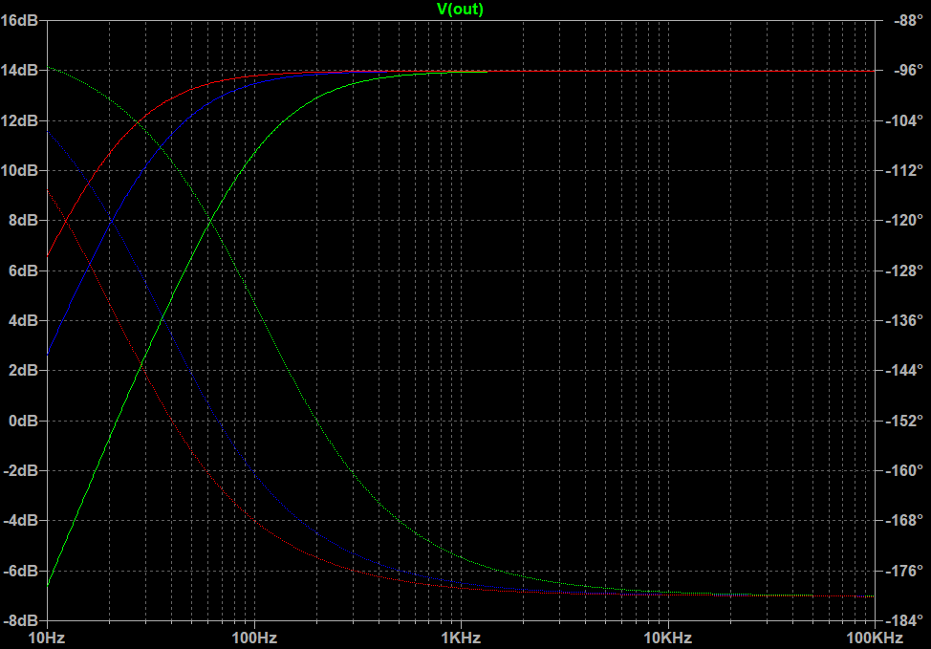
And the result is beautiful!
Francesco Sacco
linkedin.com/in/saccofrancesco

